Slide 1
Programming Fundamentals
By
Shazmeen Batool

Slide 2
Lab Task 1
Write a code to print the sum of all the elements in the array.

Slide 3
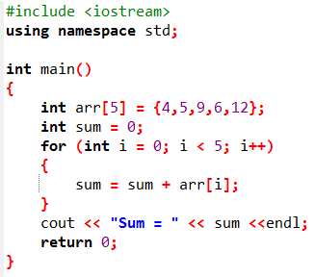


Slide 4
Lab Task 2
Read the entries of an array of 5 integers from a user. Print the sum of all the elements in the array.

Slide 5
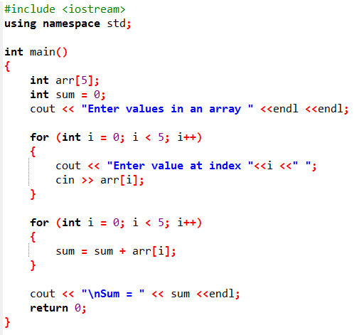
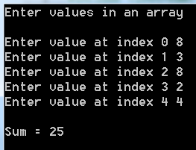

Slide 6
Lab Task 3
Read the entries of an array of 10 integers from a user.
Compute x as the average of the 10 entries and then compute the average and display those entries that are greater than or equal to x.
Print this final average.

Slide 7
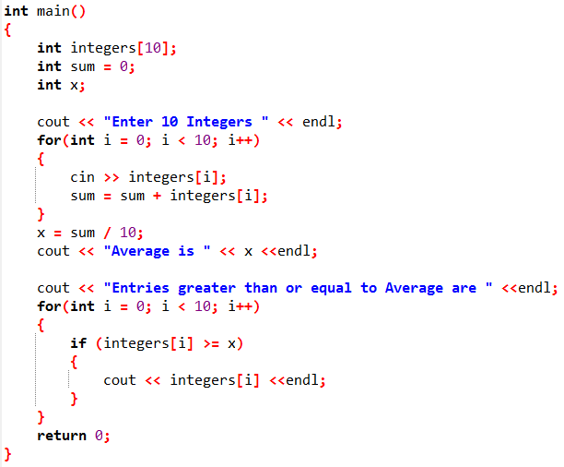
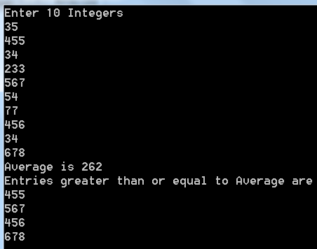

Slide 8
Lab Task 4
Write a code to find maximum number in array.

Slide 9
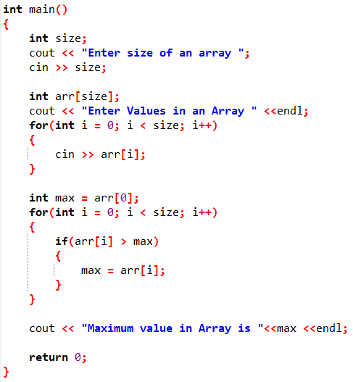
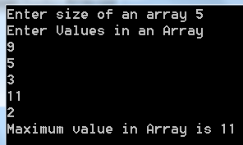

Slide 10
Lab Task 5
Write a code to find minimum number in array.

Slide 11

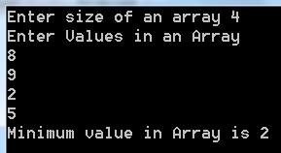

Slide 12
Lab Task 6
Write a code to swap the value of 2nd and 3rd element of the array.

Slide 13
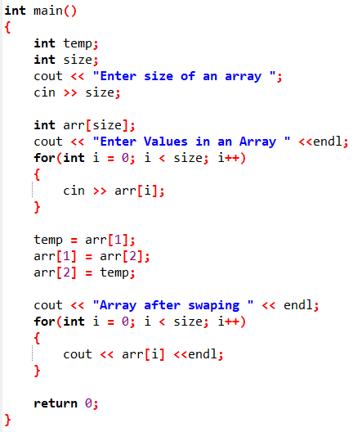
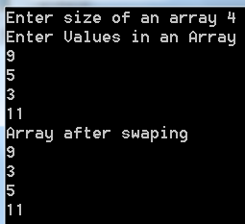

Slide 14
Lab Task 7
Take numbers from user in an array, sort them in ascending order.

Slide 15
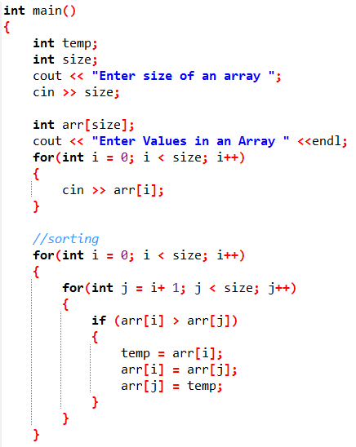
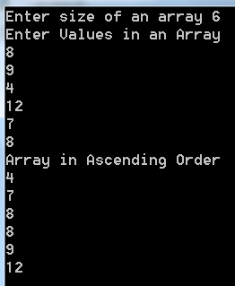
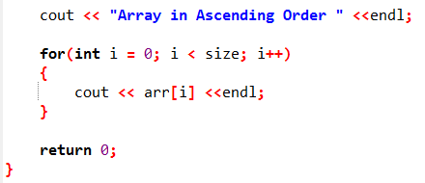

Slide 16
Lab Task 8
Take numbers from user in an array, sort them in descending order.

Slide 17
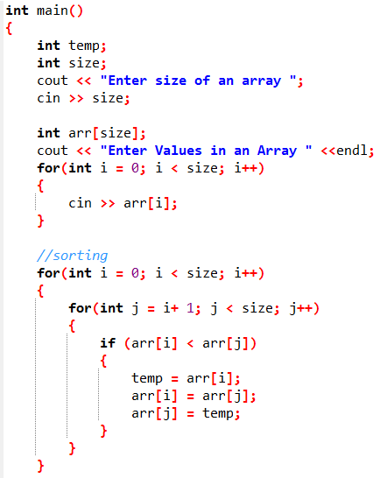
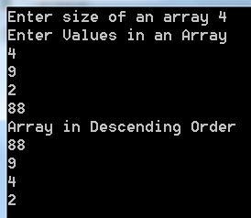
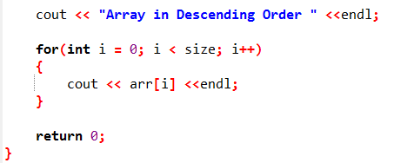

Slide 18
Lab Task 9
Take array of 5 numbers from user, now print them in reverse order.

Slide 19
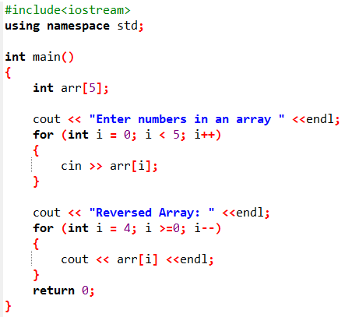
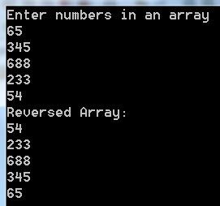

Slide 20
Lab Task 10
Take 10 float numbers from user, now find second greatest number from array.

Slide 21
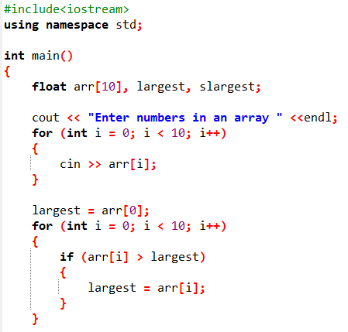
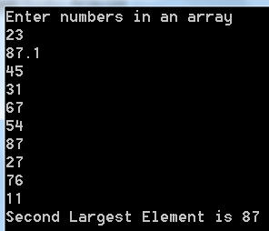
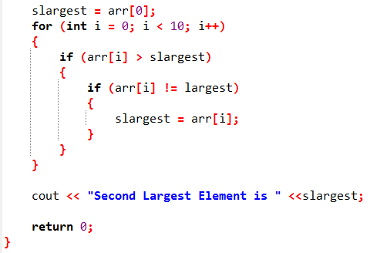

Slide 22
Lab Task 11
Write a C++ program to search any element in an array.

Slide 23
